Slide 1
NCPA OM Coaches and Coordinators Meeting for the 2020-21 season
November 14, 2020

Slide 2
Agenda
Membership Registration
Team Registration
2020-21 NCPA OM Tournament
Important Dates
Resources
Questions

Slide 3
Membership Registration
This year there are 2 membership types:
Traditional: $135, one team for each problem / division in that school
All standard membership rules apply
Virtual: $100, single team, team make-up is ad-hoc
NCPA OM recommends that teams register under a Traditional Membership
There are more and better options for tournament participation.
If there are multiple teams it is a much lower cost.
No membership packets will be mailed this year
Problem Guide is online

Slide 4
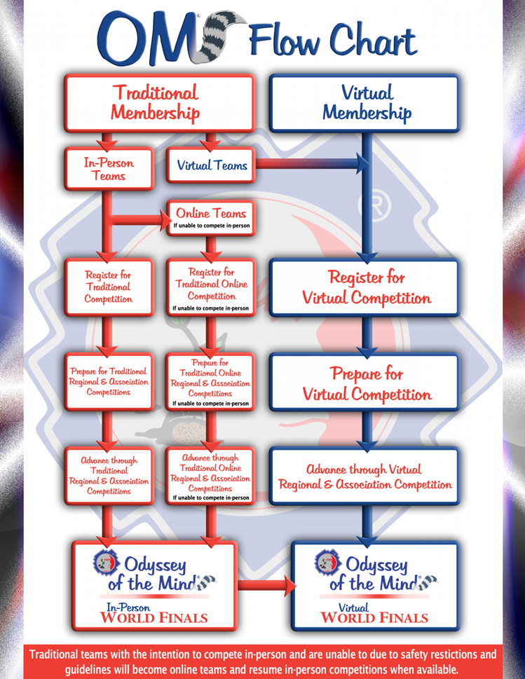
Team Registration details
The first time the Coach uses the team’s Members Area they will get asked to declare their “Intent” for the tournament type they wish to perform in.
There are 2 options for teams using a Traditional membership:
In-Person Teams:
Team has the option of participating in an “In-Person” tournament should one be offered at any stage of the competition year.
If no “In-Person” tournament option is offered at any stage, the team will participate in an “Online” ( Virtual ) tournament and be scored with all “In-Person” registered teams.
Virtual Teams:
Team will participate in Virtual tournaments at all stages of the competition year.
Teams will be scored with all “Virtual” registered teams.
If a team wants to preserve the opportunity to choose to participate in an In-Person WFs in 2021, should one be offered and they are able to attend, they need to be registered with a Traditional membership and choose the “In-Person” team option.

Slide 5
2021 NCPA Odyssey Tournament
For the 2021 program year, NCPA OM has decided that our Odyssey tournament will be hosted as an online, virtual event.
This is to assure the health and safety of all teams and officials
This also eliminates the uncertainty of how to host in-person events while the state and nation is still struggling with the pandemic.
If teams choose a Traditional membership and select the “In-Person” option NCPA OM will substitute an online tournament as an alternative.
If teams choose a Traditional membership and select the “Online” option they will compete with the virtual membership teams.
Tournament date → March 6, 2020
More details to follow

Slide 6
Team Tournament options
Teams are registering for 2 different tournament types ( In-Person/Online and Virtual ).
Both tournament types may be hosted concurrently.
One tournament event
One set of judges/officials
Scoring for each tournament type is kept separate
Teams in the “In-Person”/ “Online” group are scored together ( Red group )
Teams in the “Virtual” group are scored together ( Blue Group )
There will be 2 sets of results and 2 sets of advancing teams to the next competition level.

Slide 7
Important Dates
Virtual Coaches Training Part 1 – December 12, 2020
Topics: Long Term, Spontaneous, Style, Clarifications
Virtual Coaches Training Part 2 – January 9, 2021
Topics: Preparing for a Virtual Tournament, Paperwork
Team Registration deadline – January 15, 2021
Virtual Judges Training – TBD
Two judges per team
Online/Virtual Tournament – March 6, 2021

Slide 8
Resources
National Odyssey of the Mind website
https://www.odysseyofthemind.com
Spontaneous
https://nepaootm.com/spontaneous/
Odyssey Academy
https://youtu.be/lFQU8ZQ-20I

Slide 9
Questions

