Slide 1
NC PA Coaches Guide for 2020 - 2021
ODYSSEY OF THE MIND

Slide 2
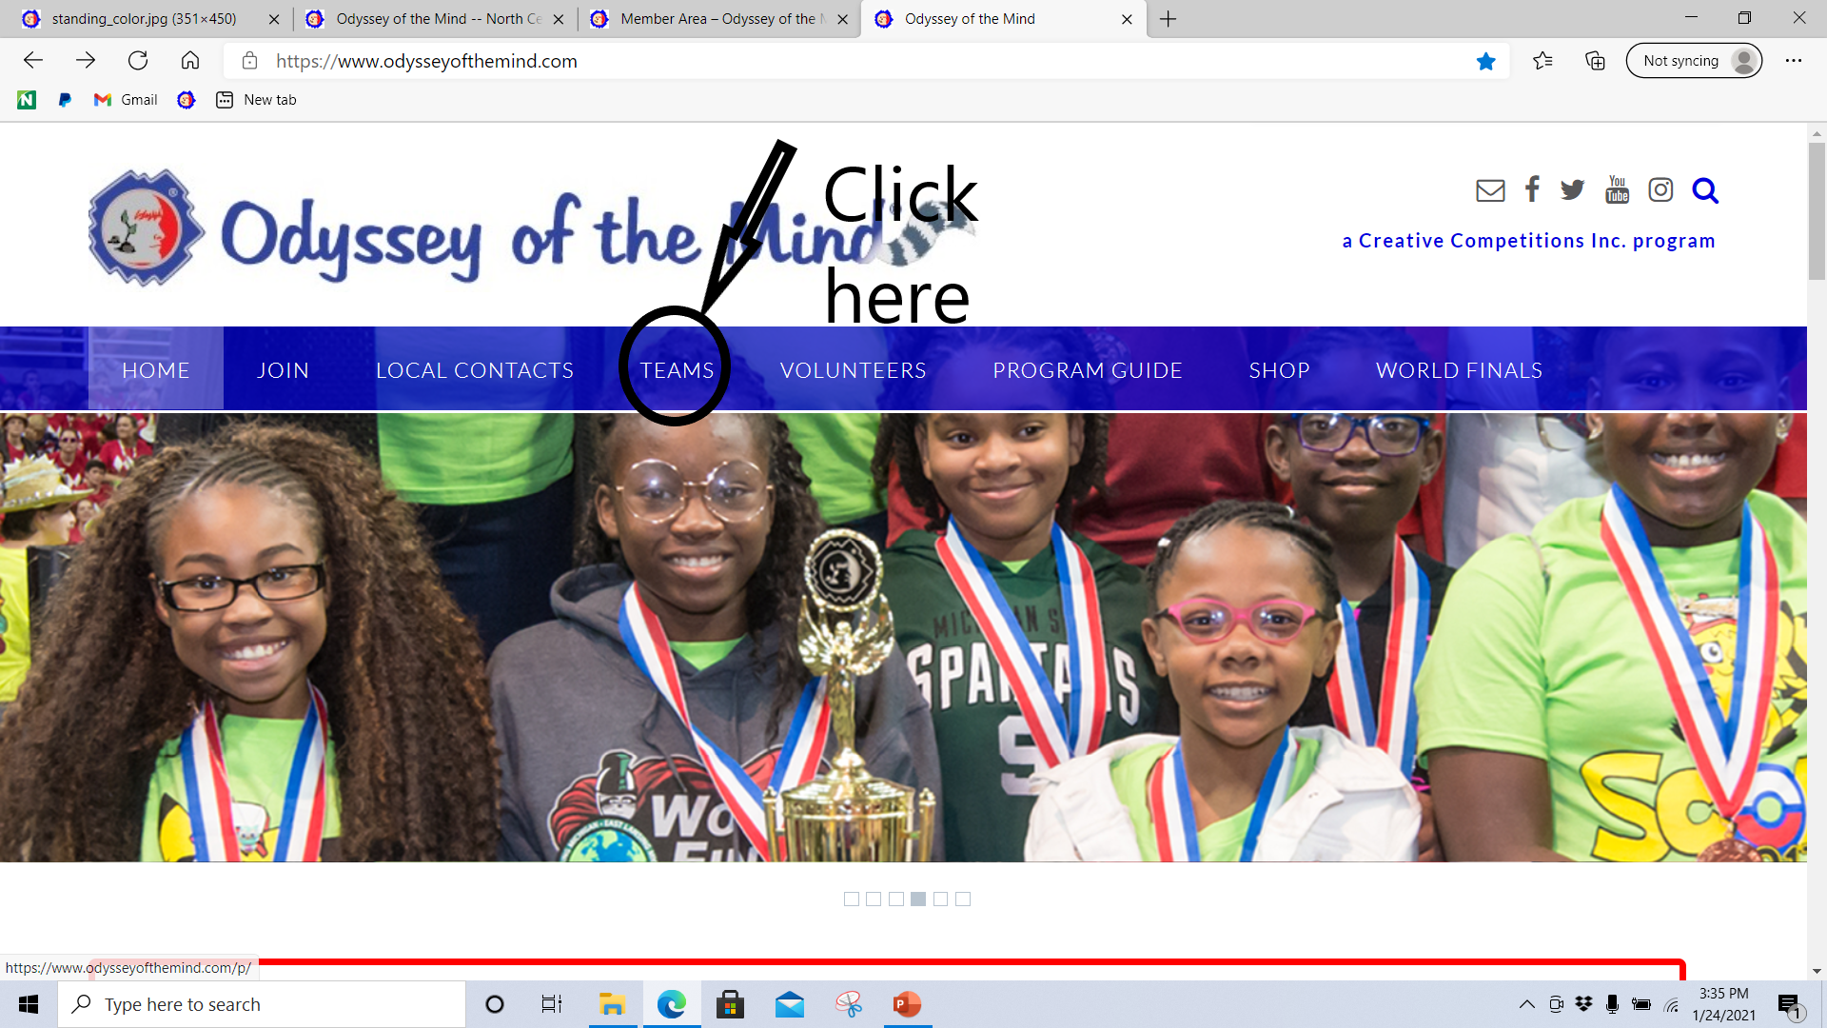
How to Navigate Members Area
On the Home page of odysseyofthemind.com

Slide 3
Members Area

Slide 4
To access the Members Area you will need your membership # and zip code
In the members area you will be able
Register a team or judge
Find the Long Term Problems, forms and Program Guide
Team Login
Contact Information for the region
Calendar for region
Various Guides for Coaches, etc.

Slide 5
Member Area

Slide 6
To access the Team Login

Slide 7
Click this to respond to officials during virtual tournament

Slide 8
Response Area

Slide 9
Communication with Odyssey Headquarters
Review the Communication Pages in the Virtual Tournament Guide for Coaches
Communication with PRO – Paperwork Review Official
Communication with HJ - Head Judge

Slide 10
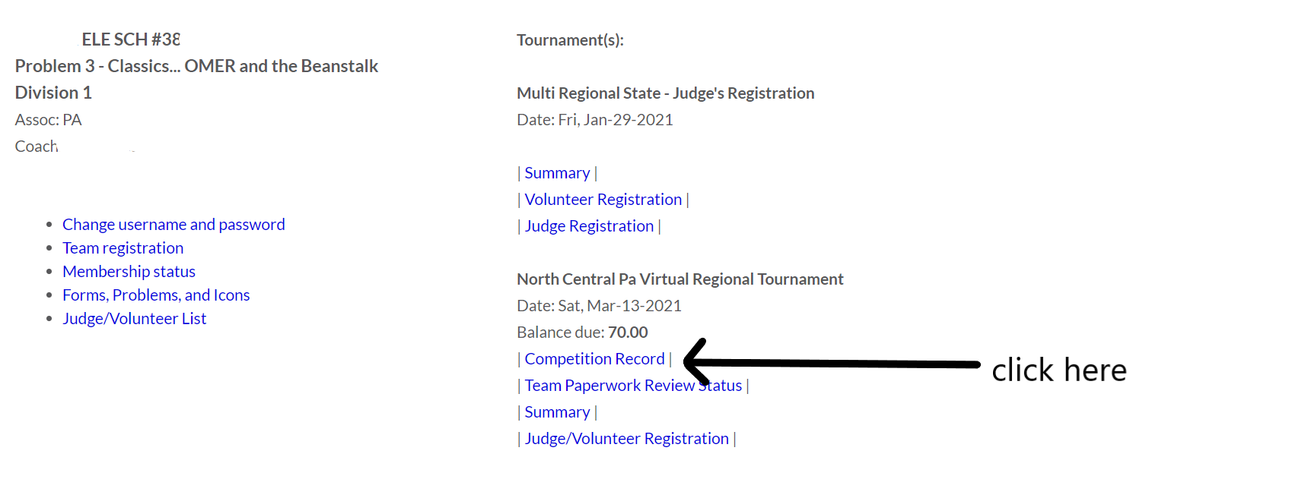
Click here to upload videos, forms, photos

Slide 11
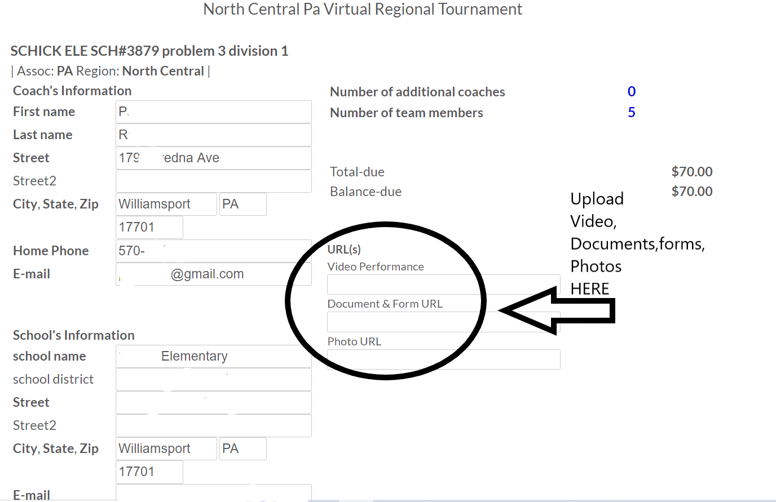
This is where you upload your video, forms and photos for virtual tournament

Slide 12
You may access forms and problems in the Member Area and in the Team Area

Slide 13
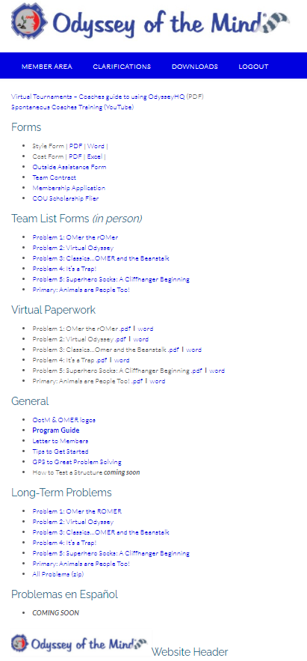
Forms, Problems and More

Slide 14
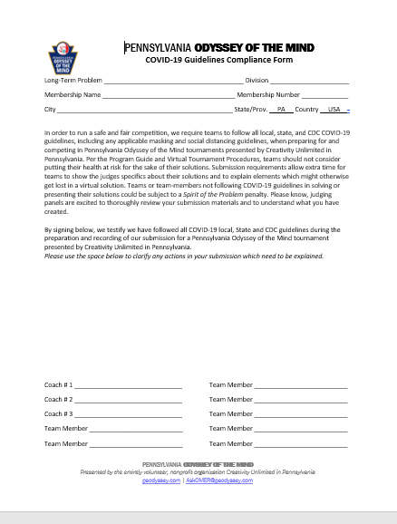
Required Form for Teams in Pennsylvania Include this when uploading forms for team

Slide 15
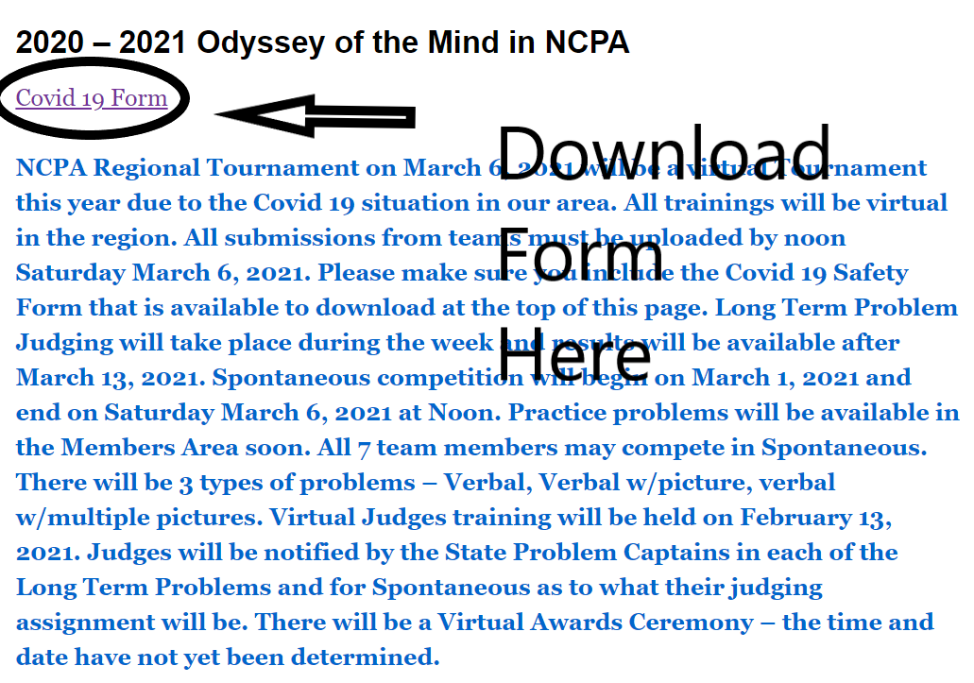
Covid 19 Safety Form can be downloaded here ncpaodyssey.org on the 2020-2021 0dyssey of the Mind in NCPA page

Slide 16
Forms that need to be uploaded
Outside Assistance
Team Required List
Cost Form
Style Form
Pa Covid 19 Safety Guidelines Form
Any Team Specific Clarifications that were received
A copy of the team’s Script is not required but can be uploaded to help facilitate the judging of the solution

Slide 17
Clarifications – have questions on long term problem – need answers

Slide 18
Clarification System – Submit them and check for new ones

Slide 19
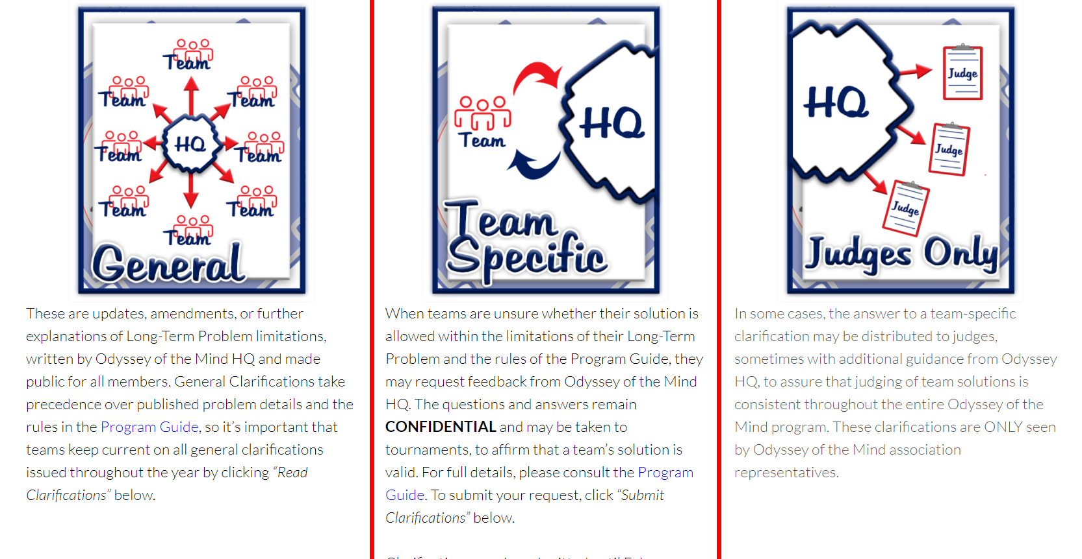
Three types of submissions

Slide 20
Deadline for Clarifications Submissions is February 15, 2021

Slide 21
Spontaneous
Spontaneous Competition will begin on February 27, 2021 – 8 AM and will end at Noon Mach 6, 2021
All 7 members may take part in the spontaneous portion of the competition.
There will be 3 types of problems
Verbal
Verbal w/picture
Verbal w/multiple pictures
Practice Problems will soon be available in the Member Area
Review
Virtual Tournament Spontaneous Guide(video)
Virtual Tournament Guide for Coaches(pdf) – section on Spontaneous

Slide 23
There is also helpful information on the Home Pageof the Odyssey of the Mind website about the virtual tournament... odysseyofthemind.com>Team>Virtual Team Resources... There is a video with tips on recording a solution, and a link to the Virtual Tournament Procedures with ALOT of helpful information, and from that page there is another link to videos from 2020 VWF.

Slide 24
Important Dates to Remember
•Virtual Judges Training – February 13, 2021
*All contact and judging information will come from State PCs
*Judges will receive their assignments from the State PCs
•Virtual Regionals
•Virtual Submissions Due – March 6, 2021, 12pm
•Virtual Awards Ceremony – March 17, 2021 (tentative)
•Virtual States
•Virtual Submissions Due – April 10, 2021, 12pm
•Virtual Awards Ceremony – April 20, 2021

Slide 25
Questions?

